Slide 1
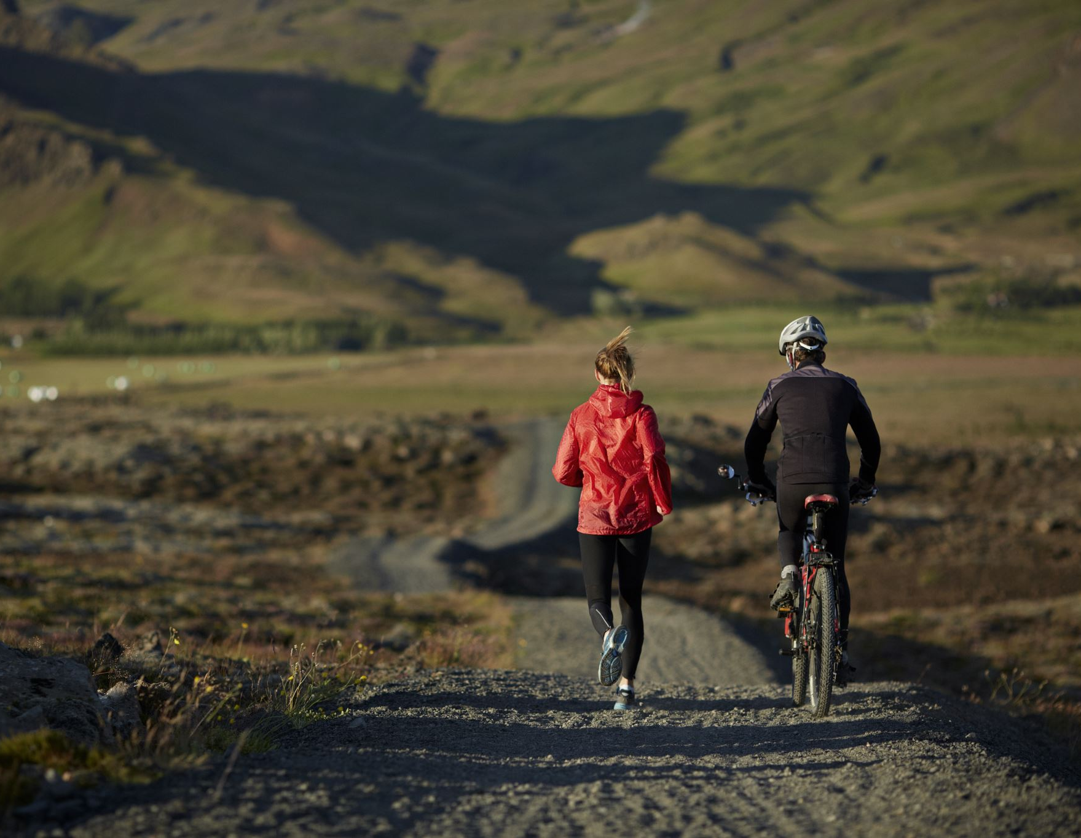
Opening a Bike Store in Tempe, AZ

Slide 2

Biking in USA Surging
The Southwest region of US has seen 100% increase in demand this year
Tempe ranked 11th in the list of Best Cycling Cities
Tempe is the highest density city in Arizona
Tempe is known for its friendliness and biking culture

Slide 3

Business Problem
Determine if there is an opportunity to open a new bike store in Tempe

Slide 4
Data Acquisition and cleaning
Use the FourSquare API to pull 10,000 venues in Tempe with a radius of 100 KM
Use Venue Name, Venue ID, Venue Category, Venue Latitude and Venue Longitude for analysis

Slide 5
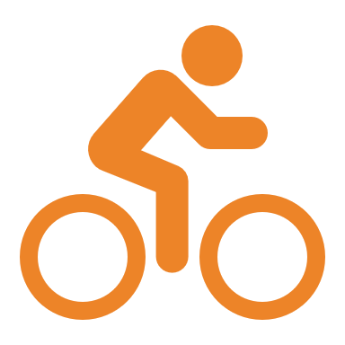
methodology
Using the data pulled from FourSquare API, identify the bike stores that operate in the Tempe Area.
Once, all the bike stores are determined, plot the stores on the map of Tempe using the Folium package in Python.
Using the bike store id feature, get the ratings for these stores.
This will help us determine how well these stores are run.

Slide 6
Results
This study showed that in a 100KM radius in Tempe, there is a single bike store albeit with a good rating.

Slide 7
Observations
This store would not be able to support the growing demand for bikes in Tempe.
The above analysis clearly demonstrates that there is a need for a new bike store in Tempe, AZ
Even though stores like Walmart sell bikes, the range of bikes sold at these stores is limited
A bike store provides the customer to buy either a new or used bike and repair their own bike in the store using the tools provided by the store

Slide 8
Conclusion
A bike store would help the customers purchase different types of bikes.
1
Provides students who are on a tight budget to maintain their own bikes in the store using the store provided equipment
2
Recommend opening another store in Tempe, AZ to reap the benefits of growing bike demand.
3

